Slide 1
Лимиты

Slide 2

When L’opital is impossible $\lim_{n→∞}{\frac{x}{x+sinx}}$
try L’opital:
$\lim_{n→∞}{\frac{1}{1+cosx}}−> not exists.$
however , the limit itself exists:
$\lim_{n→∞}{\frac{1}{1+\frac{sinx}{x}}}=\frac{1}{1±0}=0$
in order for L’opital to work we need that lopital exists, else it is inconclusive

Slide 3
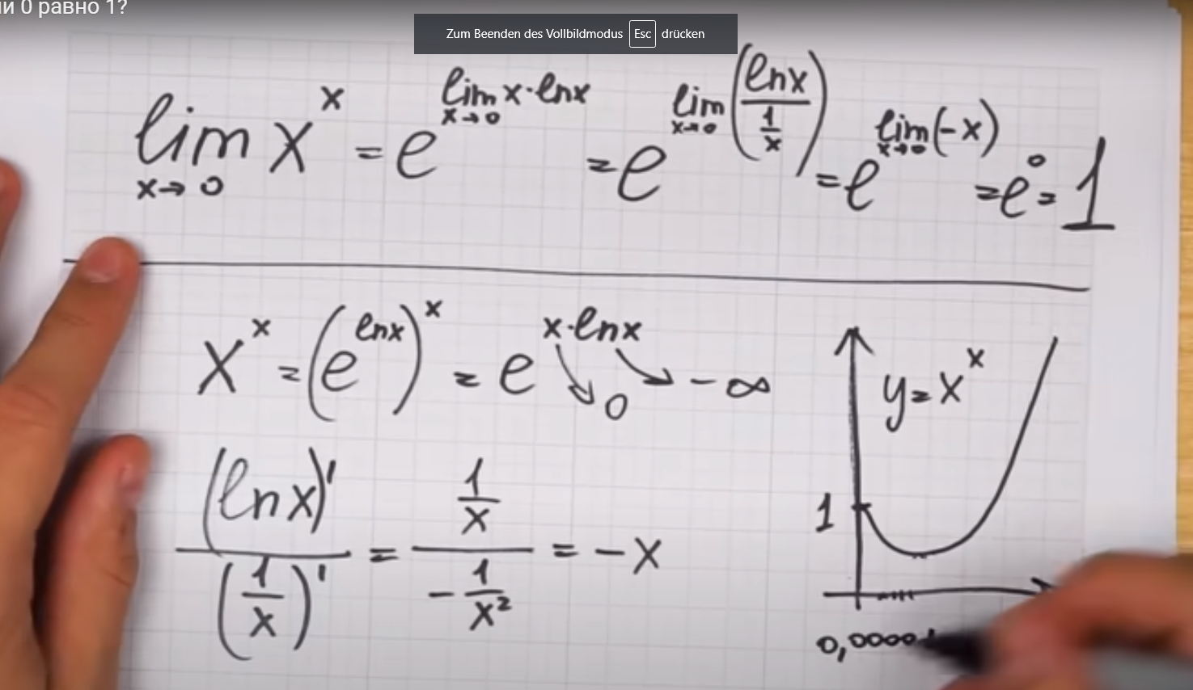
0⁰=1
Также это количество отображений пустого множества в пустое , A‘⁰₀

Slide 4
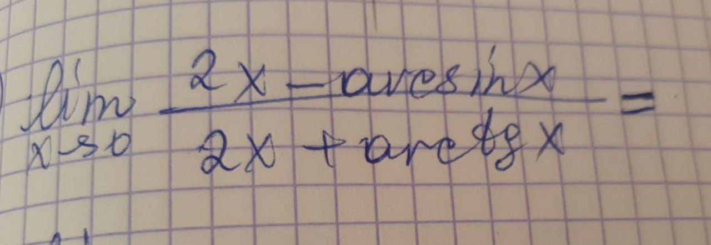
x-> 0 : arcsin x -> x, arctgx ->x
answer : 1/3

Slide 5
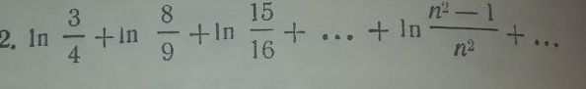
Telescope of logarithms:
ln(n^2-1)/n^2 = ln(n-1) + ln(n+1) - 2ln(n)
ln(2-1) + ln(2+1 ) - ln(2) - ln(2)+
ln(3-1) + ln(3+1 ) - ln(3) - ln(3)+
ln(4-1) + ln(4+1 ) - ln(4) - ln(4)+...= ln(1) - ln(2)=-ln(2)

Slide 6

Telescope of inverse quadratic:
$\frac{1}{(n−1)(n+1)}=\frac{1}{2}(\frac{1}{n−1}−\frac{1}{n+1})$
$\frac{1}{2^{2}−1}+\frac{1}{3^{2}−1}+\frac{1}{4^{2}−1}+... = \frac{1}{2}(\frac{1}{2−1}−\frac{1}{2+1}+\frac{1}{3−1}−\frac{1}{3+1}+\frac{1}{2−1}−\frac{1}{2+1}$

Slide 7
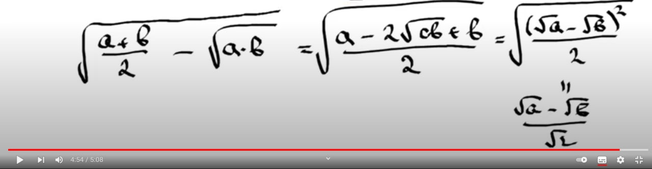

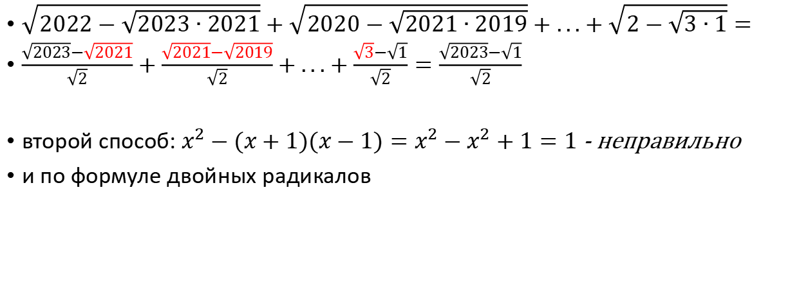
Telescope of double radical, version 2:
$\sqrt{2022−\sqrt{2023∙2021}}+\sqrt{2020−\sqrt{2021∙2019}}+...+\sqrt{2−\sqrt{3∙1}}=$
$\frac{\sqrt{2023}−\sqrt{2021}}{\sqrt{2}}+\frac{\sqrt{2021}−\sqrt{2019}}{\sqrt{2}}+...+\frac{\sqrt{3}−\sqrt{1}}{\sqrt{2}}=\frac{\sqrt{2023}−\sqrt{1}}{\sqrt{2}}$
второй способ: $x^{2}−(x+1)(x−1)=x^{2}−x^{2}+1=1$ - неправильно
и по формуле двойных радикалов

Slide 8

$\sum_{n=0}^{inf}{\frac{n+1}{1000n+1}}>\sum_{n=0}^{inf}{\frac{n+1}{1000n+1000}}=\sum_{n=0}^{inf}{\frac{n+1}{1000(n+1)}}=\sum_{n=0}^{inf}{\frac{1}{1000}}=inf$
sum_(n=1)^∞ 1/(n^2 + 1) = 1/2 (π coth(π) - 1)≈1.0767
$\sqrt[n]{\frac{n^{2}}{2^{n}(n+1)}}=\frac{1}{2}\frac{1}{\sqrt[n]{\frac{1}{n}+\frac{1}{n^{2}}}}=main$
$\lim_{n →∞}{\sqrt[n]{\frac{1}{n}+\frac{1}{n^{2}}}=L}$
ln(L)=$\lim_{n→∞}{\frac{ln(\frac{1}{n}+\frac{1}{n^{2}})}{n}}=диф. верх и низ по n =\lim_{n→∞}{(ln(\frac{1}{n}+\frac{1}{n^{2}}))‘=\lim_{n→∞}{\frac{−\frac{1}{n^{2}}−\frac{1}{n^{3}}}{\frac{1}{n}+\frac{1}{n^{2}}}}}=$
$\lim_{n→∞}{\frac{−\frac{1}{n^{1}}−\frac{1}{n^{2}}}{1+\frac{1}{n}}=0}$
L=$e^{lnL}=e^{0}=1$
main=$\frac{1}{2}\frac{1}{1}$

Slide 9

Замена переменной на котнстанту
$\sum_{n=1}^{∞}{\frac{n^{4}}{{\left(\ln{n}\right)}^{n}}}<\sum_{n=1}^{∞}{\frac{n^{4}}{c^{n}};c is const, c∈N};$

Slide 10
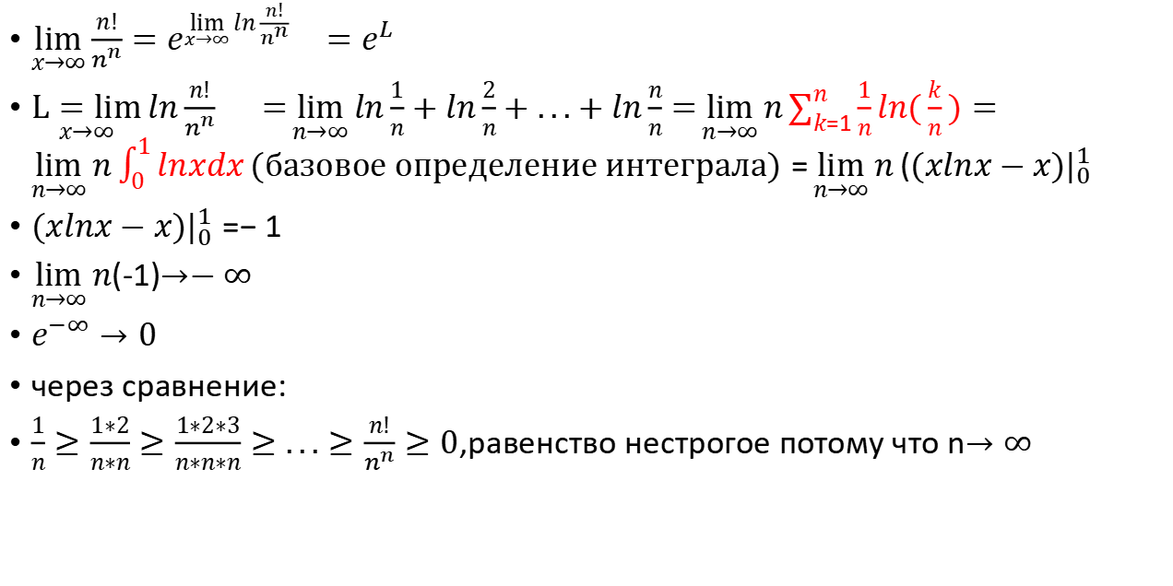
Опять $\lim_{x→∞}{\frac{n!}{n^{n}}}$, базовое определение интеграла
$\lim_{x→∞}{\frac{n!}{n^{n}}}=e^{\lim_{x→∞}{ln\frac{n!}{n^{n}}}{}}=e^{L}$
$\underset{x→∞}{L=lim}{ln\frac{n!}{n^{n}}}{}=\lim_{n→∞}{ln\frac{1}{n}+ln\frac{2}{n}+...+ln\frac{n}{n}}=\lim_{n→∞}{n\sum_{k=1}^{n}{\frac{1}{n}ln(\frac{k}{n}})}=\lim_{n→∞}{n}\int_{0}^{1}{lnxdx}(базовое определение интеграла)=\lim_{n→∞}{n}((xlnx−x)|_{0}^{1}$
$(xlnx−x)|_{0}^{1}=−1$
$\lim_{n→∞}{n}$(-1)$→−∞$
$e^{−∞}→0$
через сравнение:
$\frac{1}{n}≥\frac{1∗2}{n∗n}≥\frac{1∗2∗3}{n∗n∗n}≥...≥\frac{n!}{n^{n}}≥0$,равенство нестрогое потому что n$→∞$

Slide 11
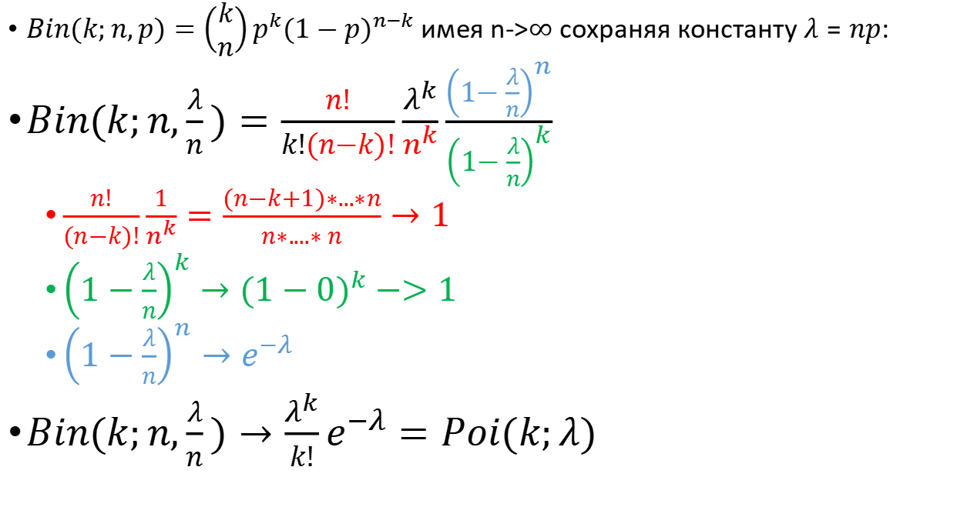
Лимит биноминального распределения
$Bin(k;n,p)=\left(\begin{matrix}k \\ n\end{matrix}\right)p^{k}{(1−p)}^{n−k}$имея n->$∞$ сохраняя константу $λ=np:$
$Bin(k;n,\frac{λ}{n})=\frac{n!}{k!(n−k)!}\frac{λ^{k}}{n^{k}}\frac{{\left(1−\frac{λ}{n}\right)}^{n}}{{\left(1−\frac{λ}{n}\right)}^{k}}$
$\frac{n!}{(n−k)!}\frac{1}{n^{k}}=\frac{(n−k+1)∗...∗n}{n∗....∗ n}→1$
${\left(1−\frac{λ}{n}\right)}^{k}→{(1−0)}^{k}−>1$
${\left(1−\frac{λ}{n}\right)}^{n}→e^{−λ}$
$Bin(k;n,\frac{λ}{n})→\frac{λ^{k}}{k!}e^{−λ}=Poi(k;λ)$

Slide 13

$$\lim_{n→∞}{n!−a^{n}}→∞$$
view $\frac{n!}{a^{n}}=\frac{1∗2∗3...∗a∗(a+1)∗...∗n}{a∗a∗a...∗a∗a∗...∗a}=\frac{1∗2∗3...∗a}{a^{a}}\frac{(a+1)∗...∗n}{a^{n−a}}$
$\frac{1∗2∗3...∗a}{a^{a}} is const for finite a, but \frac{(a+1)∗...∗n}{a^{n−a}} is infinity for n →∞ then$
$\frac{n!}{a^{n}}→∞$
$\lim_{n→∞}{n!−a^{n}}=\lim_{n→∞}{a^{n}(\frac{n!}{a^{n}}−1)}→∞∗∞=∞$

Slide 14
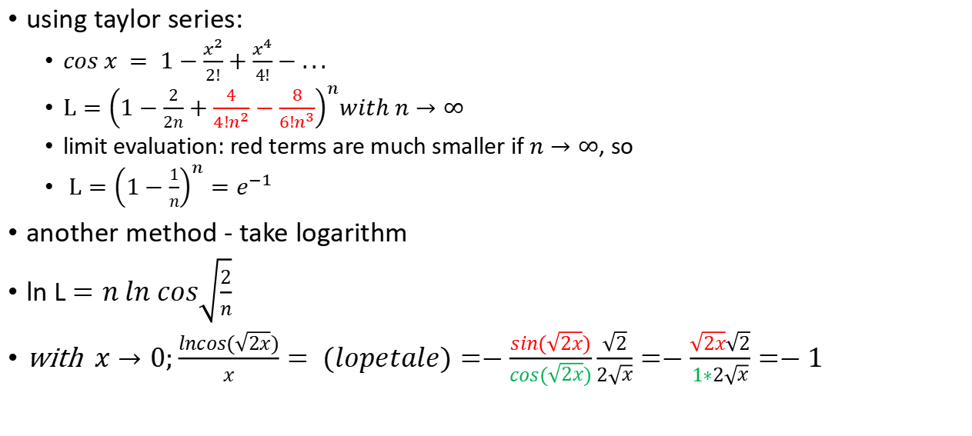

$$L=\lim_{n→∞}{\cos^{n}{\sqrt{\frac{2}{n}}}}$$
using taylor series:
$cos x = 1−\frac{x^{2}}{2!}+\frac{x^{4}}{4!}−...$
$L={\left(1−\frac{2}{2n}+\frac{4}{{4!n}^{2}}−\frac{8}{6!n^{3}}\right)}^{n}with n→∞$
limit evaluation: red terms are much smaller if $n→∞$, so
$L={\left(1−\frac{1}{n}\right)}^{n}=e^{−1}$
another method - take logarithm
ln L $=n ln cos\sqrt{\frac{2}{n}}$
with $x→0;\frac{lncos(\sqrt{2x})}{x}= (lopetale)=−\frac{sin(\sqrt{2x})}{cos(\sqrt{2x})}\frac{\sqrt{2}}{2\sqrt{x}}=−\frac{\sqrt{2x}\sqrt{2}}{1∗2\sqrt{x}}=−1$

Slide 15


$$\lim_{n→∞}{{\left(1+\frac{d}{an^{2}+bn+c}\right)}^{n}}$$
$=\lim_{n→∞}{{\left(1+\frac{d}{an^{2}+bn+c}\right)}^{n\frac{d}{an^{2}+bn+c}\frac{an^{2}+bn+c}{d}}}=e^{\underset{n→∞}{lim\frac{n}{an^{2}+bn+c}}}=e^{0}=1$

Slide 16

$$\lim_{n →∞}{\sqrt[n^{2}]{1^{n}+2^{n}+{...+n}^{n}}}=L$$
squeeze limit:
$\lim_{n →∞}{\sqrt[n^{2}]{n^{n}}}≤L≤\lim_{n →∞}{\sqrt[n^{2}]{n^{n}+n^{n}+{...+n}^{n}}}=\lim_{n →∞}{\sqrt[n^{2}]{n^{n+1}}}$
$\sqrt[n^{2}]{n^{n}}=n^{\frac{n}{n^{2}}}=n^{\frac{1}{n}}→1$
$\sqrt[n^{2}]{n^{n+1}}=n^{\frac{n+1}{n^{2}}}=n^{\frac{1}{n}}n^{\frac{1}{n^{2}}}→1$
so
1 $≤L≤1; L = 1$

Slide 17

$$\lim_{n→∞}{\frac{1+\frac{1}{\sqrt{2}}+...+\frac{1}{\sqrt{n}}}{\sqrt{n}}}$$
video How To Bound Sums Like A Pro

